Slide 1


Slide 2
Part 1 React Introduction and Basics
Introduction
Basics

Slide 3
HTML and CSS.
JavaScript fundamentals
JavaScript ES6 features
Prerequisites

Slide 4
React Introduction

Slide 5

What is React?

Slide 6
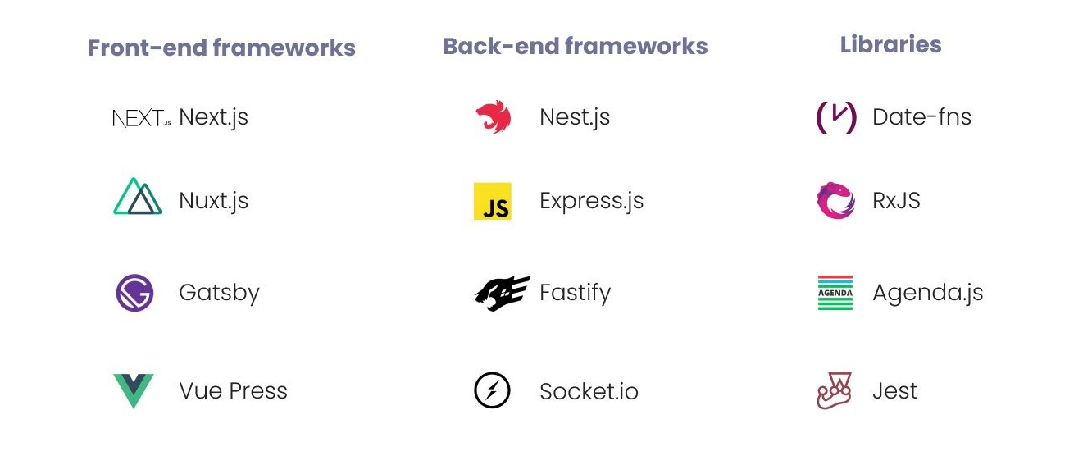

What is React ?

Slide 7
Framework vs Library

Slide 8
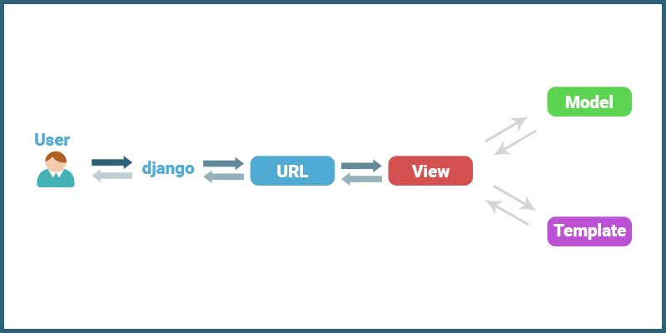
Framework vs Library

Slide 9
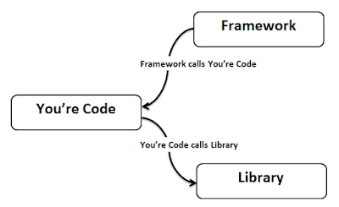
Framework vs Library

Slide 10
JavaScript ?

Slide 11

“A JavaScript Library For Building User Interfaces”.

Slide 12
Why is React?

Slide 13
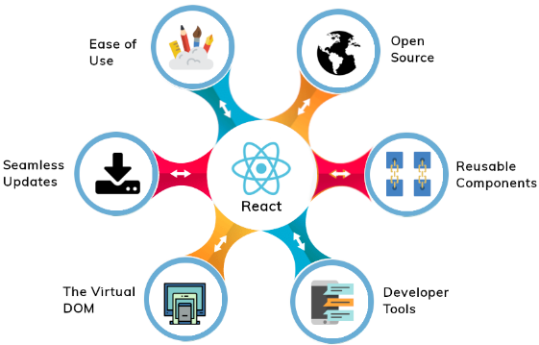

Slide 14
Virtual DOM
Diffing
Reconciliation
Batched update

Slide 15
DOM stands for Document Object Model and is an abstraction of a structured text.
DOM

Slide 16
Diffing
The comparison between the virtual DOMs

Slide 17
The process of keeping virtual DOM in sync with the real DOM
Reconciliation

Slide 18
Batched update

Slide 19
Developer Tools
The React Devtools extension for Chrome and Firefox

Slide 20
npx create-react-app react-app
Toolchain

Slide 21
NPM VS NPX

Slide 22
package runner

Slide 23


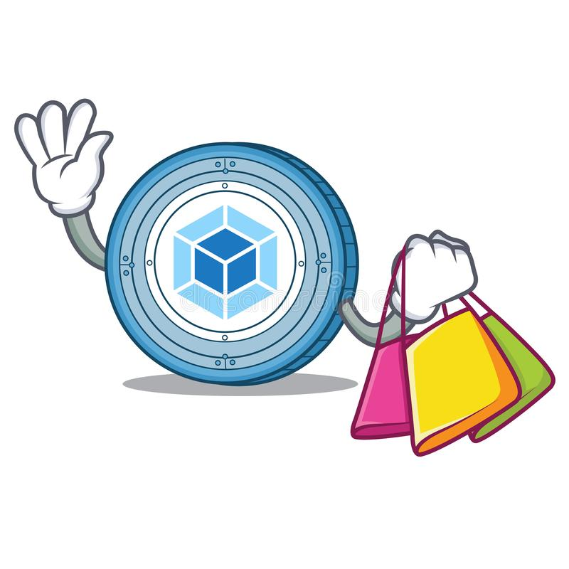
Package manager +
Compiler +
Bundler

Slide 24


A package manager Yarn or npm
It lets you take advantage of a vast ecosystem of third-party packages, and easily install or update them.

Slide 25

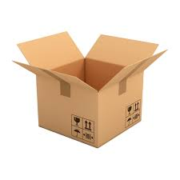
A bundler
webpack or Parcel
It lets you write modular code and bundle it together into small packages to optimize load time.

Slide 26
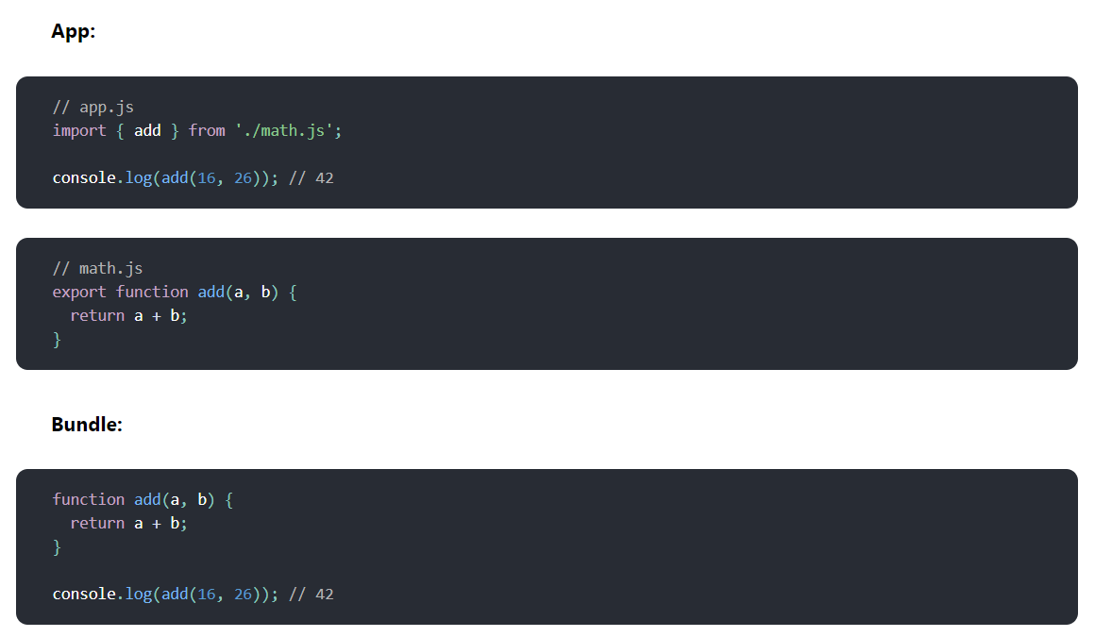

Slide 27
A compiler
Babel
It lets you write modern JavaScript code that still works in older browsers.

Slide 28
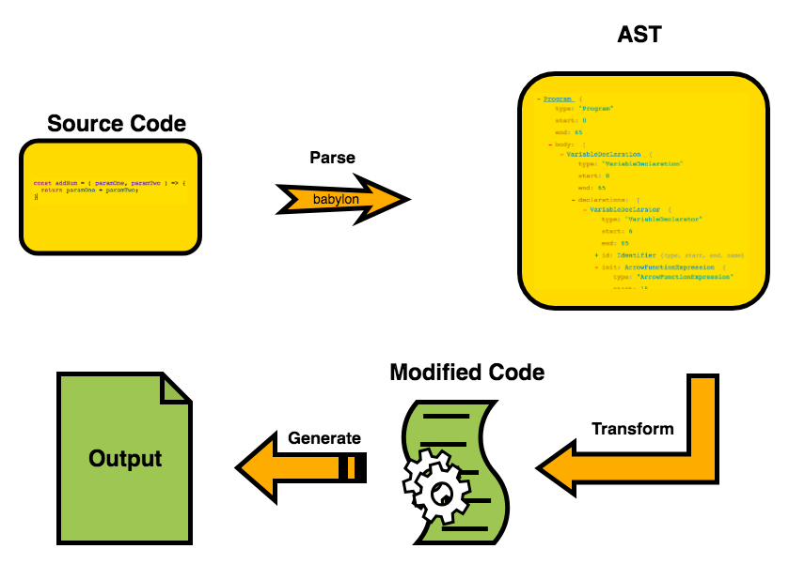

Slide 29
Toolchain variations

Slide 30
Toolchain variations
learning React or creating a new single-page app
Create React App
server-rendered website with Node.js
Next.js
static content-oriented website
Gatsby

Slide 31
Strict Mode
React StrictMode is a feature added in version 16.3 and aimed to help us in finding potential problems in an application.

Slide 32
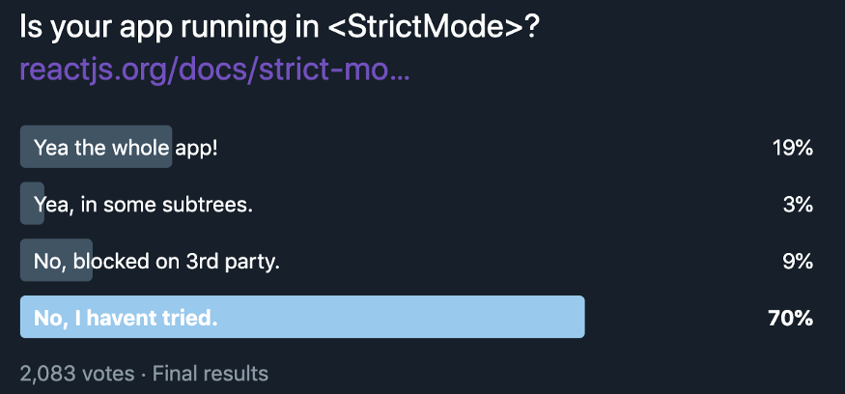

Slide 33
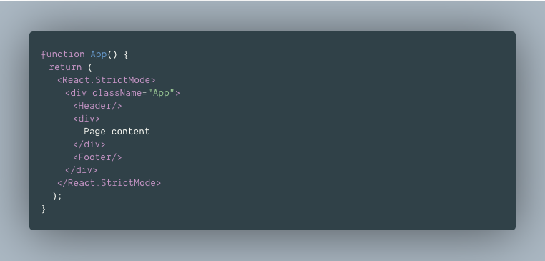

Slide 34
Components

Slide 35
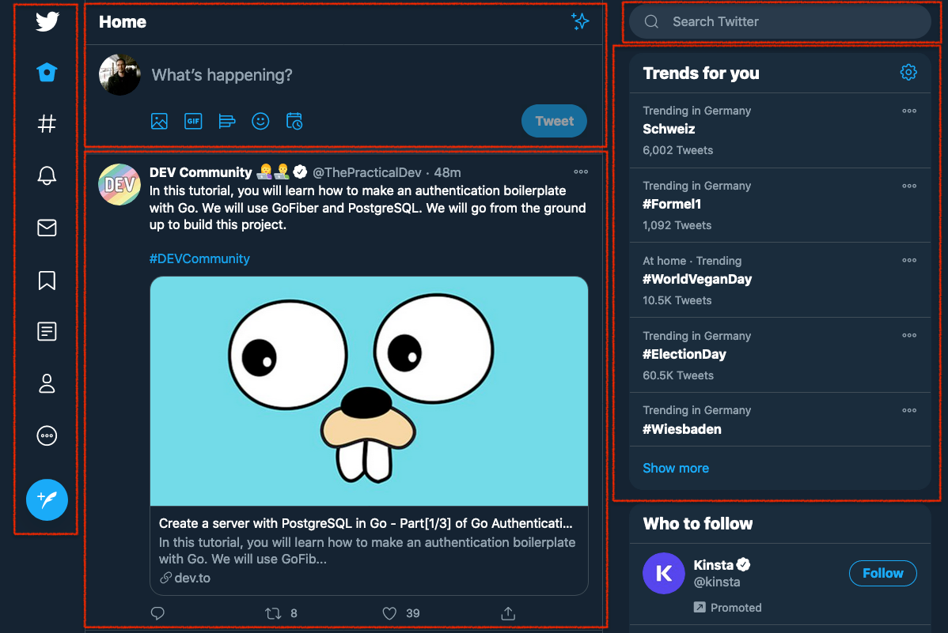

Slide 36
Components
Class Component
Functional Component

Slide 37
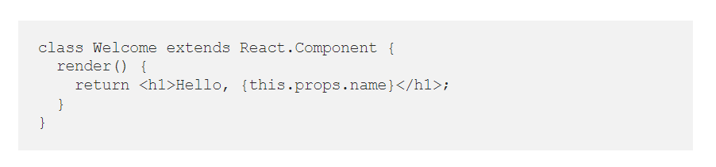
Class components are ES6 classes that return JSX

Slide 38
A Class Component:
is an ES6 class, will be a component once it ‘extends’ a React component.
takes Props (in the constructor) if needed
must have a render( ) method for returning JSX

Slide 39
Components
Class Component
Functional Component

Slide 40
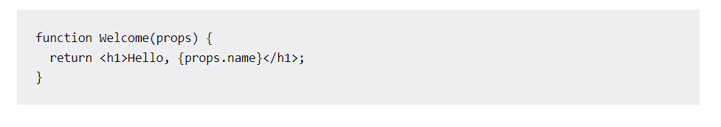
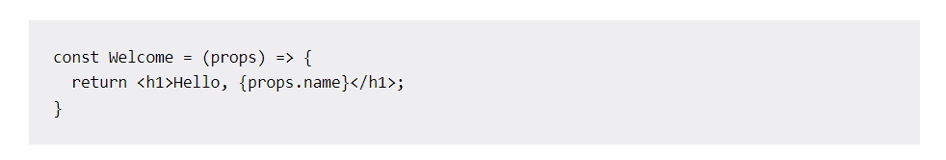
A functional component is basically a JavaScript/ES6 function that returns a React element (JSX)

Slide 41
So, a Functional Component in React:
is a JavaScript/ES6 function
must return a React element (JSX)
always starts with a capital letter (naming convention)
takes props as a parameter if necessary

Slide 42
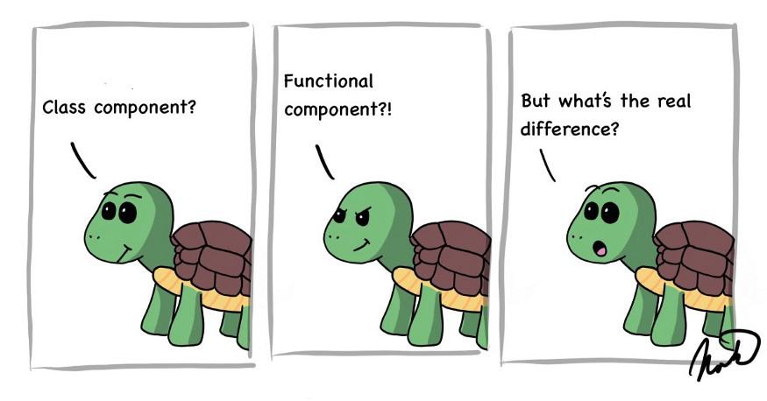

Slide 43
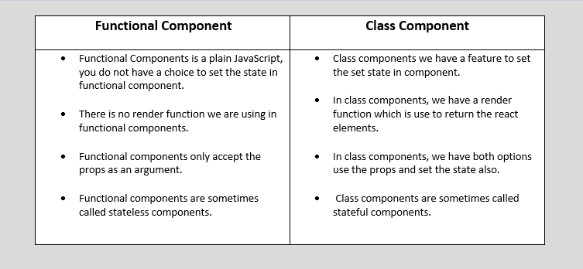

Slide 44
JSX – JavaScript XML

Slide 45
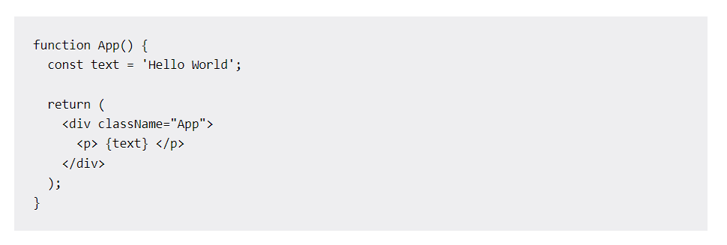
special and valid syntax extension for React which is called JSX (JavaScript XML)

Slide 46
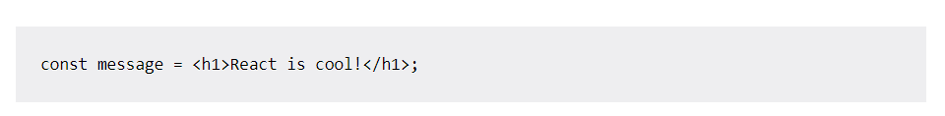
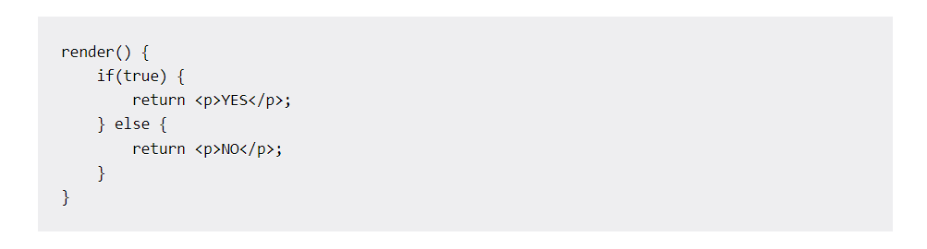

Slide 47
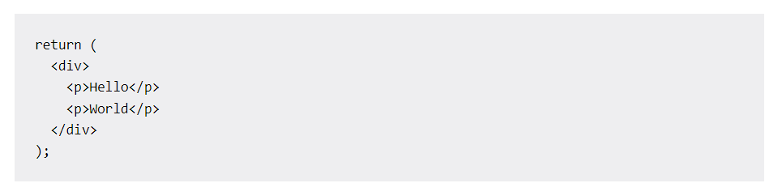
HTML and component tags must always be closed < />
“class” “className”
“tabindex” “tabIndex”
We can’t return more than one HTML element at once, so make sure to wrap them inside a parent tag:

Slide 48
Props and State

Slide 49
Props is short for properties, and they are used to pass data between React components.
React’s data flow between components is uni-directional (from parent to child only).

Slide 50
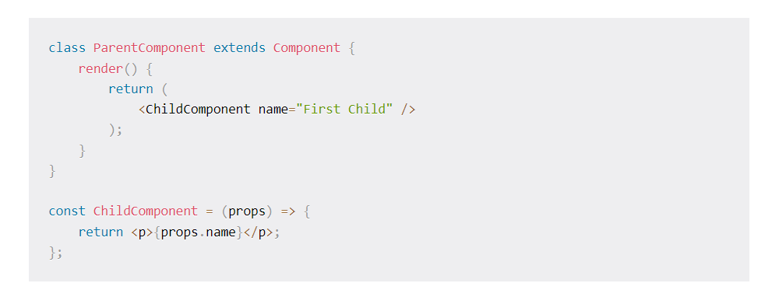

Slide 51

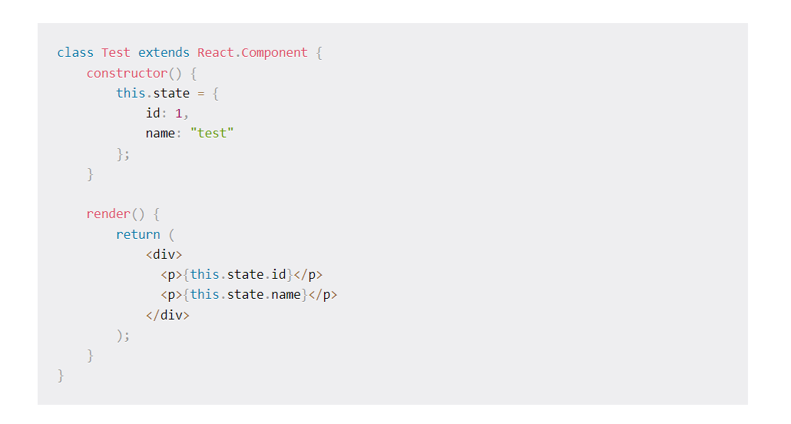

Slide 52
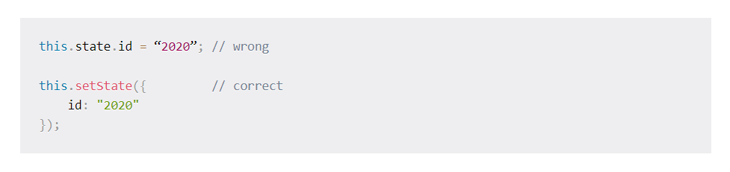
setState()

Slide 53
What are the differences between props and state?
Components receive data from outside with props, whereas they can create and manage their own data with state
Props are used to pass data, whereas state is for managing data
Data from props is read-only, and cannot be modified by a component that is receiving it from outside
State data can be modified by its own component, but is private (cannot be accessed from outside)
Props can only be passed from parent component to child (unidirectional flow)
Modifying state should happen with the setState ( ) method

Slide 54
Lifting State up

Slide 55
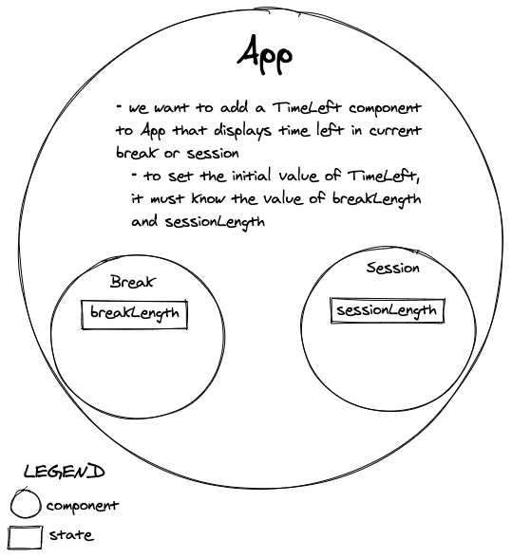

Slide 56
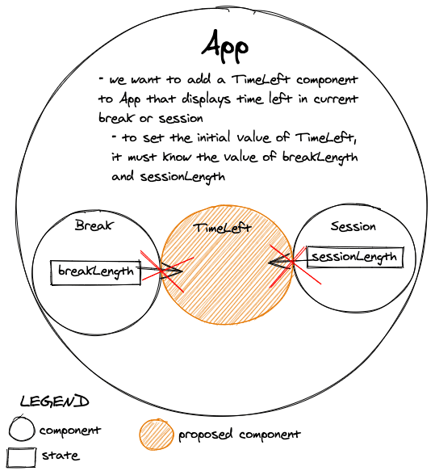

Slide 57
Thank You!

